Slide 1
Storage

Slide 2




Azure Storage ACCOUNTS
Blob Storage
Object and Disk Storage
Blog Storage Tiers
Azure Search integration
File Storage
SMB File Shares
Attach to VMs as file shares
Azure File Sync
Table Storage
NoSQL Data Store
Schema-less design
Azure Cosmos DB
Queue Storage
Message based
For building synchronous apps
Notes:
There are four main types of storage services available within an Azure Storage Account. Each type is designed for specific use cases and workloads:
Blob Storage:
This is Azure’s object storage solution for the cloud.
It supports unstructured data like images, videos, backups, and logs.
Blob storage offers different access tiers—Hot, Cool, and Archive—to optimize cost based on how frequently data is accessed.
It also integrates with services like Azure Search for indexing and querying large datasets.
File Storage:
Provides fully managed file shares in the cloud that use the SMB protocol.
These shares can be mounted by Azure VMs or on-premises systems.
Azure File Sync allows you to cache and sync Azure file shares on Windows Servers for hybrid scenarios.
Table Storage:
A NoSQL key-value store for rapid development using structured, non-relational data.
It’s schema-less, making it flexible and scalable for applications like user profiles or device metadata.
For more advanced capabilities, it can be integrated with Azure Cosmos DB.
Queue Storage:
Designed for message-based communication between application components.
It’s ideal for building decoupled and scalable applications, especially in distributed systems where components need to communicate asynchronously.
Each of these storage types can be accessed through a single Azure Storage Account, making it a versatile and powerful foundation for cloud-based applications

Slide 3










Azure Storage account endpoints
Azure Storage Account
https://mystorageaccount.queue.core.windows.net
https://mystorageaccount.table.core.windows.net
https://mystorageaccount.file.core.windows.net
https://mystorageaccount.blob.core.windows.net
Notes:
This slide illustrates the different service-specific endpoints provided by an Azure Storage Account. Each endpoint corresponds to a different type of storage service within the account:
Blob Endpoint https://mystorageaccount.blob.core.windows.net
Used to access Blob Storage, which stores unstructured data like documents, images, and backups.
File Endpoint https://mystorageaccount.file.core.windows.net
Used for accessing Azure File Storage, which provides SMB-based file shares.
Table Endpoint https://mystorageaccount.table.core.windows.net
This is for Table Storage, a NoSQL key-value store for structured data.
Queue Endpoint https://mystorageaccount.queue.core.windows.net
Used to interact with Queue Storage, which supports message-based communication between application components.
Each of these endpoints is automatically created when a storage account is provisioned. They allow applications to interact with the respective services using REST APIs or SDKs, and they follow a consistent naming convention based on the storage account name.

Slide 4
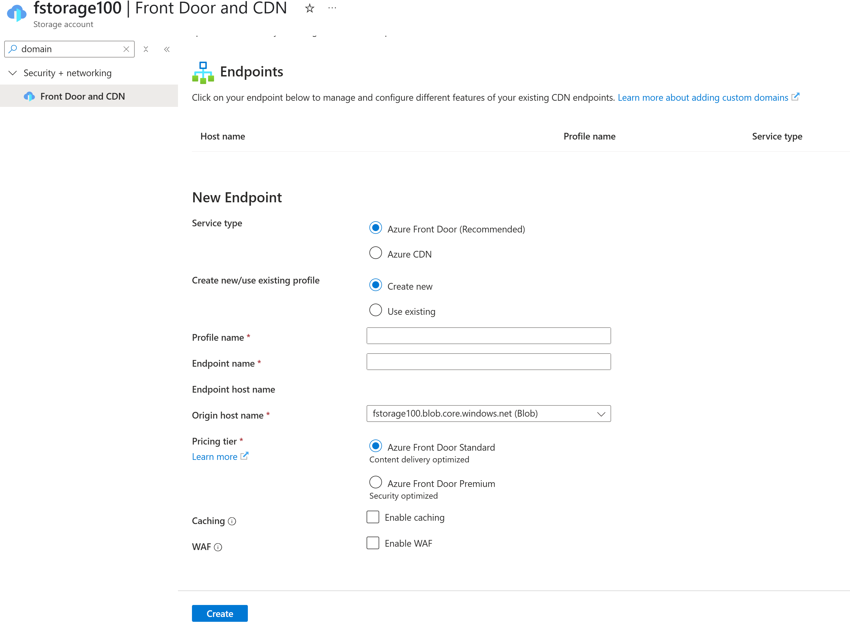
Azure storage custom domain name
Azure Storage accounts can be accessed using custom domain names setup with Azure Front Door.
Notes:
Azure Storage accounts can be accessed using custom domain names.
By default, Azure provides a domain name for each storage account, such as:
http://mystorageaccount.blob.core.windows.net
However, for branding or integration purposes, you can configure a custom domain, like:
http://storage.cisco.com
This allows you to serve content from your storage account using a domain name that aligns with your organization’s identity. It’s especially useful for static website hosting or public-facing content.
To set this up, you need to:
Register your custom domain.
Create a CNAME record in your DNS settings that maps your custom domain to the Azure-provided endpoint.
Configure the custom domain in the Azure portal under your storage account settings.
This feature enhances professionalism and user trust, especially when delivering content directly from Azure Blob Storage.

Slide 5





Azure blob storage types
Block Blob
190.7 TB Max file size
Composed of 4000MB blocks
Insert, replace, delete blocks
Append Blob
195GB Max file size
Can only append blocks
Ideal for log/audit files
Page Blob
8TB max file size
Frequent read/write operations
Standard/Premium Storage
Notes:
1. Block Blob
Purpose: Best for storing text and binary data, such as documents, media files, and backups.
Structure: Composed of blocks, each up to 4000 MiB (approx. 3.8 GB) in size.
Max Size: Up to 190.7 TiB when using block blob with Azure Data Lake Storage Gen2 hierarchical namespace.
Operations: Supports uploading, replacing, and deleting individual blocks before committing them to the blob.
Use Cases: Media streaming, backup, and general-purpose file storage.
2. Append Blob
Purpose: Optimized for append operations, where data is added to the end of the blob.
Max Size: Up to 195 GiB.
Operations: Only supports appending blocks; existing content cannot be modified.
Use Cases: Ideal for logging, telemetry, and audit data where new entries are continuously added.
3. Page Blob
Purpose: Designed for frequent read/write operations with random access.
Max Size: Up to 8 TiB.
Storage Tiers: Available in both Standard and Premium performance tiers.
Use Cases: Used primarily for Azure virtual machine disks (OS and data disks), database files, and other I/O-intensive workloads.

Slide 6
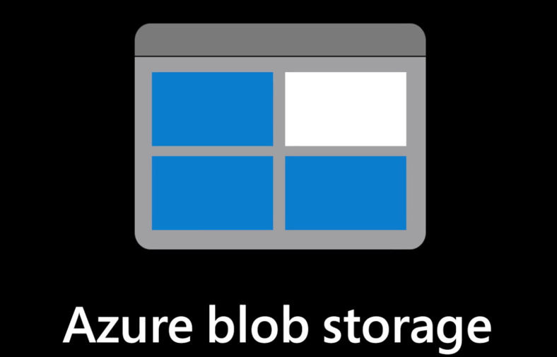
Use cases
Big Data & Analytics
Data Lakes (ADLS Gen2)
Machine Learning input/output
All Big Data Pipelines
Cloud-Native Workloads
Web apps, containers, and microservices
Blob storage for static content, logs, and unstructured.
AI / ML & HPC
Training datasets, inference results
Temporary Compute Staging (e.g, scratch disks)
Long-Term & Archival Storage
Cloud and archive tiers for compliance, backups, or rarely accessed data.

Slide 7
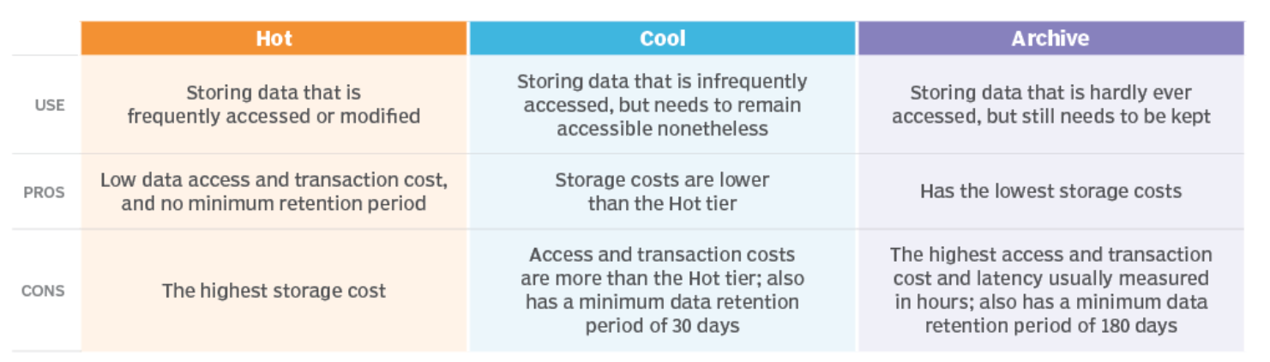
BLOB STORAGE tiers
https://www.linkedin.com/pulse/azure-storage-lifecycle-management-optimizing-data-nidhi-kumari-5naxe/
Notes:
Blob storage provides many tiers for storing files/objects.
Each tier has different pricing and use cases.
Premium, hot, cool, cold and archive tiers exist.
Premium is the most expensive for storage and archive is the cheapest
Premium is the cheapest for fast, frequent access and archive is the most expensive.

Slide 8

Demo – Create azure storage account with python
Setup and Prerequisites
Azure Subscription Ensure you have an active subscription and required permissions.
Python 3.8+ Environment
python --version
Install Required Packages
sudo apt-get update
pip install azure-identity azure-mgmt-resource azure-mgmt-storage azure-storage-blob

Slide 9
Demo – Create azure storage account with python
import os
from azure.identity import DefaultAzureCredential
from azure.mgmt.resource import ResourceManagementClient
from azure.mgmt.storage import StorageManagementClient
SUBSCRIPTION_ID = "" # Replace with your Azure subscription ID
LOCATION = "eastus"
RG_NAME = "demo-rg"
STORAGE_ACCOUNT_NAME = "demostorageacct2030" # Must be globally unique
cred = DefaultAzureCredential()
rg_client = ResourceManagementClient(cred, SUBSCRIPTION_ID)
stg_client = StorageManagementClient(cred, SUBSCRIPTION_ID)
rg_client.resource_groups.create_or_update(RG_NAME, {"location": LOCATION})
print(f"Resource group '{RG_NAME}' created in {LOCATION}")
stg_async = stg_client.storage_accounts.begin_create(
RG_NAME, STORAGE_ACCOUNT_NAME,
{
"location": LOCATION,
"sku": {"name": "Standard_LRS"},
"kind": "StorageV2",
"enable_https_traffic_only": True
}
)
stg_account = stg_async.result()
print(f"Storage account '{STORAGE_ACCOUNT_NAME}' created")
Create a project directory:
mkdir blobdemo & cd blobdemo
touch provision_blob.py
Add the provisioning code
Run:
az login
python provision_blob.py

Slide 10
Demo – Upload to azure storage account with python
# upload_blob.py
import os, uuid
from azure.identity import DefaultAzureCredential
from azure.storage.blob import BlobServiceClient
ACCOUNT_NAME = "demostorageacct2030" # Replace with your storage account name
ACCOUNT_URL = f"https://{ACCOUNT_NAME}.blob.core.windows.net"
CONTAINER_NAME = "demo-container"
LOCAL_FILE_PATH = "data/myfile.txt"
BLOB_NAME = f"{uuid.uuid4()}-{os.path.basename(LOCAL_FILE_PATH)}"
# Authenticate and connect
blob_service_client = BlobServiceClient(ACCOUNT_URL, credential=DefaultAzureCredential())
# 1. Create container if missing
try:
container_client = blob_service_client.create_container(CONTAINER_NAME)
print(f"Container '{CONTAINER_NAME}' created.")
except Exception:
container_client = blob_service_client.get_container_client(CONTAINER_NAME)
print(f"Using existing container '{CONTAINER_NAME}'.")
# 2. Upload blob
blob_client = container_client.get_blob_client(BLOB_NAME)
with open(LOCAL_FILE_PATH, "rb") as f:
blob_client.upload_blob(f)
print(f"Uploaded blob: {BLOB_NAME}")
Create an upload script
touch upload_blob.py
Add the file upload code
Run:
python upload_blob.py
Notes:
You might need to add IAM permissions to write to the container

Slide 11
Pop quiz:
Scenario: Your team must ensure blobs can never be deleted or overwritten for 7 days, except under legal hold. Which feature supports this?
A. Read-access geo-redundant storage (RA-GRS) B. Immutable Blob Storage policies with retention C. Soft-delete and versioning D. Premium GPv2 with snapshots enabled

Slide 12
Pop quiz:
Scenario: Your team must ensure blobs can never be deleted or overwritten for 7 days, except under legal hold. Which feature supports this?
A. Read-access geo-redundant storage (RA-GRS) B. Immutable Blob Storage policies with retention C. Soft-delete and versioning D. Premium GPv2 with snapshots enabled
Notes:
Immutable Blob Storage enables time-based retention or legal hold, preventing deletion or modification within the retention window

